Slide 1

Python for Data Analysis and Visualization
Intro to Pandas
Instructor: Claudia Carroll

Slide 2

Lecture: Crash Course on Python Basics

Slide 3

Data Types
Strings | "Heuston, we have a problem"
Integers | 35
Floats | 35.6
Booleans | True/False

Slide 4
Data Collection Types
List: ["apple", 12, "computer science", "apple", 13.2] Order is saved Can be rearranged after list is defined Can contain duplicates Elements can be added or removed Indicated by square brackets | Set: {"orange", "house", 102} Order is not saved (unordered) Cannot contain duplicates Cannot add or remove elements once defined Indicated by curly brackets
Tuple : ("apple", 29, 32) Order is saved Order cannot be rearranged after tuple is defined Can contain duplicates Elements cannot be added or removed Indicated by parentheses | Dictionary: {"name": "Anne", "age": 19, "major": "communications"} Stores data in key/value pairs Order is saved (as of Python 3.7) Duplicate values permitted, but not duplicate keys within one item Elements can be added and removed Indicated by curly brackets and colons

Slide 5
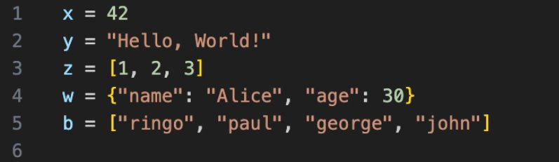
Identify Data Types

Slide 6
Indices
An index is the position of a subset of data within a data type (e.g. letters in a string, or elements in a list)
In python, the index starts with 0
Elements can be access by index with the following syntax: list[i]
Example:
>>> fruits = ["apples", "oranges", "melons"]
>>> print(fruits[1])
"oranges"

Slide 7
Boolean Statements
A Boolean statement is a statement that is either True or False
Boolean statements are primarily used to filter data or methods based on certain conditions
Boolean statements are usually produced using Boolean operators
>>> age = 15
>>> print(age < 12)
False
>>> print (age > 12)
True

Slide 8
Arithmetic Operators
+ | Addition
- | Subtraction
* | Multiplication
/ | Division
% | Modulus (divide and return the remainder)
** | Exponential
// | Floor division (divide and round down to the nearest whole number)

Slide 9
Comparison Operators
== | Equal to
!= | Not equal to
> | Greater than
< | Less than
>= | Great than or equal to
<= | Less than or equal to

Slide 10
Conditionals
Used to filter data for further operations
number = 0
if number > 0:
print('Positive number’)
elif number <0:
print('Negative number’)
else:
print('Zero') print('This statement is always executed')

Slide 11
For Loops
Used to iterate over a sequence of data (string, list, dictionary etc.)
Can be nested
Syntax:
fruits = ["apple", "banana", "cherry"]
for x in fruits:
for letter in x:
print(letter)

Slide 12
Functions
Blocks of pre-written code
Created by user or included in Python libraries
Must be defined before being called
Data can be passed to a function as arguments
foods = [“eggs”, “bread”, “milk”, “cookies”]
>>> def long_strings(x):
for food in foods:
if len(food) > 5:
print(food)
return
>>> print(long_string(foods))
cookies

Slide 13
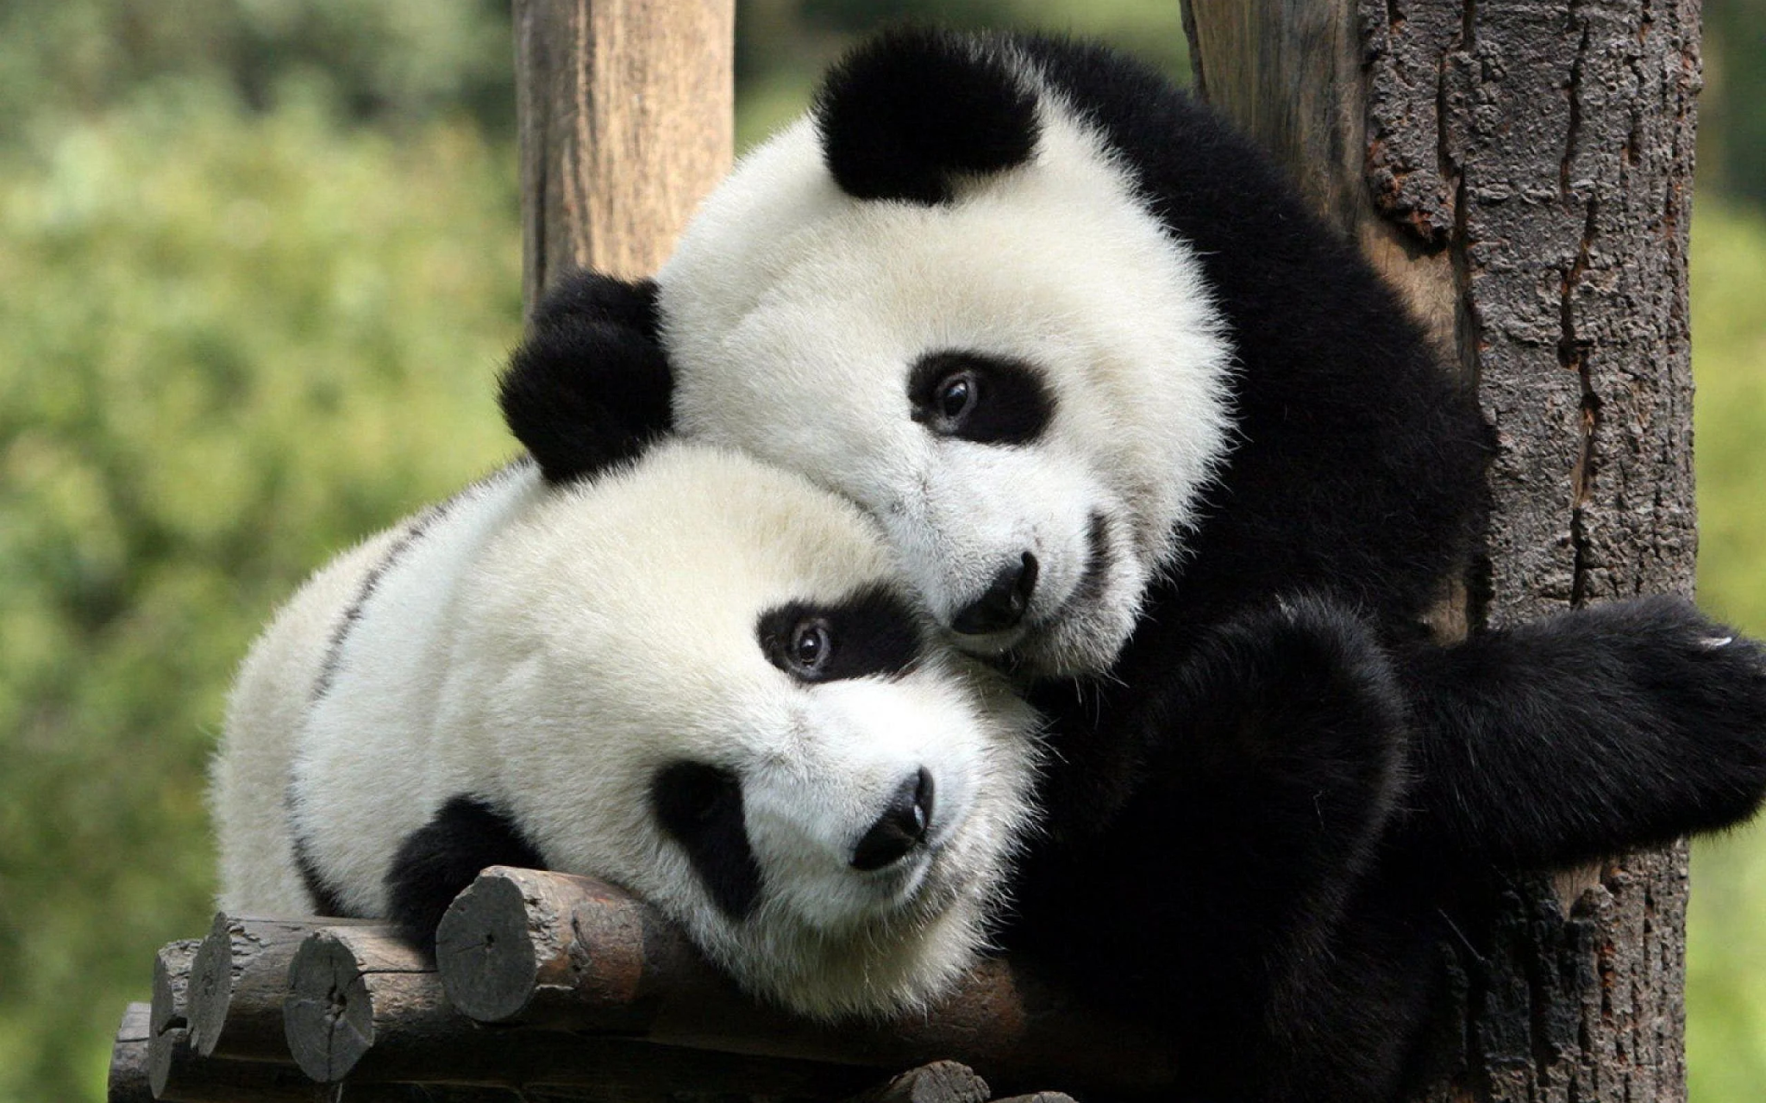
Pandas!

Slide 14
What is Pandas?
The most common Python library for basic data manipulation
Particularly suited to working with tabular data (csv, tsv, excel etc.)
Reads tabular data (or any 2-dimensional data form) as a dataframe
A dataframe is a 2-dimensional array in python

Slide 15
Loading Different File Types in Pandas
read_csv | CSV files
read_tsv | TSV files
read_excel | Any excel file format or equivalent (xlsx, xls, ods)
read_json | 2-dimensional JSON files
read_table | Other delimited tabular files (delimiter must be specified)

Slide 16
Demo: Intro to Pandas

